Slide 1

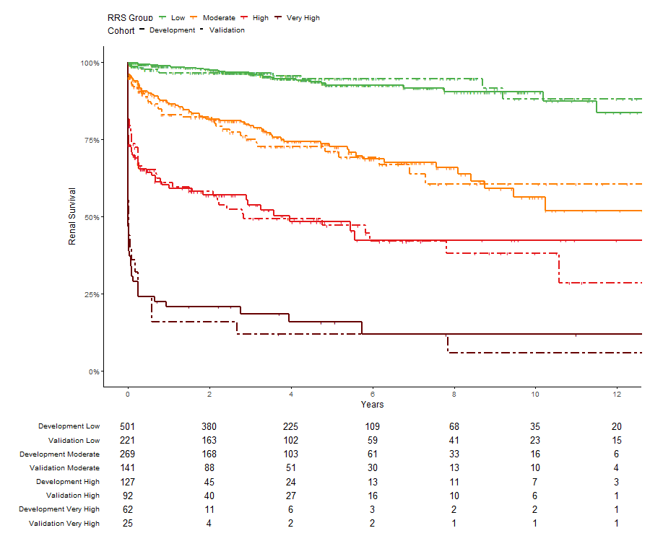





Modification of the Renal Risk Score in ANCA Associated
Glomerulonephritis improves prediction further
Sebastian Bate, MMath^{1,2}, Silke R Brix, MD MRCP^{3,4}
¹Research and Innovation, Manchester University NHS Foundation Trust; ²Centre for Biostatistics, University of Manchester; ³Division of Cell Matrix Biology and Regenerative Medicine, University of Manchester; ⁴Renal, Transplantation and Urology Unit, Manchester University NHS Foundation Trust
Background
Anti-neutrophil cytoplasmic antibody (ANCA) associated vasculitides are multiorgan autoimmune disorders. Renal involvement is very common and disease presentation heterogeneous. Reliable prediction tools are needed to improve prognostication and personalisation of treatment. We aimed to validate and update the Renal Risk Score (RRS) [1] and explore other factors in renal survival in the largest cohort ever assembled.
Materials and methods
We investigated a retrospective multicentre international longitudinal cohort from referral centres and registries around the world (Angers, Baltimore, London, Manchester, Mexico City, Prague, Preston, Salford, Uludağ, and the Irish and Scottish registries). Included were patients with a biopsy proven ANCA associated glomerulonephritis (GN). The primary endpoint was end stage kidney disease (ESKD) defined as renal replacement therapy (RRT) for at least 12 weeks and continued until last follow up. Patients were censored at last follow-up. Kaplan-Meier estimates and Harrell’s C were used to assess model performance. Cox Proportional Hazards were used to reweigh risk factors and develop a modified scoring system, with points assigned proportional to the parameters’ beta coefficients. The Renal Risk Score was calculated for each patient using the estimated glomerular filtration rate (eGFR) at presentation (G0: eGFR>15 ml/min/1.73m², G1: eGFR≤15 ml/min/1.73m²), the percentage of normal glomeruli in the kidney biopsy (N0: normal >25%, N1: normal 10%-25%, N2: <10%) and the simplified cut-off for interstitial fibrosis and tubular atrophy (T0: IFTA none, mild (or <25%), T1: IFTA mild to moderate – severe (or ≥25%)). Normal glomeruli were defined as glomeruli without any scarring, crescents or fibrinoid necrosis within in the tuft. Each parameter was assigned points (G1=3, N1=4, N2=6, T1=2, G0=N0=T0=0) and summed, creating a total score and risk groups: low (0), moderate (2 - 7), and high (8 - 11 points).
Results
Of a total of 1591 patients, 1439 were included in the final analyses (959 in the development cohort, 52% male, median age 64 years, median follow-up 3.6 years, Supplementary Tables 1&2). The RRS demonstrated a discrimination of C=0.800, comparable to the original cohort (Supplementary Table 3). Reweighing, we found an additional useful cut-off for kidney function and further replaced glomerular filtration rate with serum creatinine which provided a higher reliability. We modified the score creating four risk groups with an additional continuous model to supply risk percentages and groups. The new risk score replaces eGFR with creatinine and adds a second cut off (C0: <250 μmol/L, C1: 250-450 μmol/L, C2: >450 μmol/L). The model concordance was C=0.831 (C=0.815 in validation), as well as further splitting the high risk group into high and very high because of clear differences in survival.
 | n (%) | β | HR | Points
Creatinine (μmol)
C0: < 250 | 534 (55.7) | Ref |  | 0
C1: 250 – 450 | 241 (25.1) | 0.661 | 1.94 (1.30-2.89) | 4
C2: > 450 | 184 (19.2) | 1.886 | 6.59 (4.59-9.45) | 11
Normal Glomeruli (%)
N0: > 25 | 590 (61.5) | Ref |  | 0
N1: 10 - 25 | 177 (18.5) | 0.650 | 1.92 (1.30-2.82) | 4
N2: < 10 | 192 (20.0) | 1.199 | 3.32 (2.35-4.69) | 7
IFTA (%)
T0: < 25 | 469 (48.9) | Ref |  | 0
T1: ≥ 25 | 490 (51.1) | 0.527 | 1.69 (1.28-2.26) | 3
Points | Group
0-4 | Low
5-11 | Moderate
12-18 | High
21 | Very High
Tables
Modified RRS, its coefficients, points and risk groupings.
Figure
Kaplan Meier plot of the modified RRS in the development and validation cohorts. There was strong agreement between cohorts for each risk group.
Future work
App for bedside use (currently in proof of concept) Treatment pathway stratification by risk (trial pending sponsorship)
Conclusion
We demonstrated the out-of-sample validity of the RRS and propose a modification of the score to improve prognostication and risk stratification for treatment and clinical trials. We believe that the risk score will be able to provide reliable predictions of renal survival and assist in decision making to balance benefits and risks of aggressive immunosuppression.
References
[1] Brix, Silke R., et al. "Development and validation of a renal risk score in ANCA-associated glomerulonephritis." Kidney international 94.6 (2018): 1177-1188.
eSupplement
github.com/sgbstats/ANCA
Contact Details
Sebastian Bate
Research and Innovation, Manchester University NHS Foundation Trust
Sebastian.bate@mft.nhs.uk
Position in Translational Pathway
D1 | D2 | D3 | D4 | T1 | T2 | T3 | T4
www.translation.manchester.ac.uk @Translation_Mcr #TranslationMCR2022 translation@manchester.ac.uk

